Slide 1
Oakwood Presbyterian Church
2020

Slide 2
The Doctrines of Grace, Part I
“The central truth of God’s saving grace is succinctly stated in the assertion, ‘Salvation is of the Lord.’ This strong declaration means that every aspect of man’s salvation is from God and is entirely dependent upon God. The only contribution that we make is the sin that was laid upon Jesus Christ at the cross.”
Steven Lawson

Slide 3
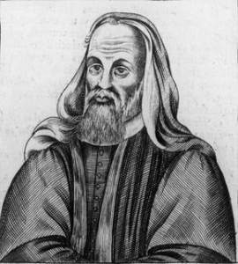
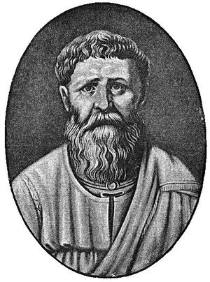
Augustine and Pelagius
Pelagius (354-420 AD) – an ascetic; denied original sin; taught that man had free will, and could avoid sin and please God by his own efforts
Teachings spread rapidly
Augustine (354-430) led the defense of the Gospel against Pelagius’ teachings

Slide 4
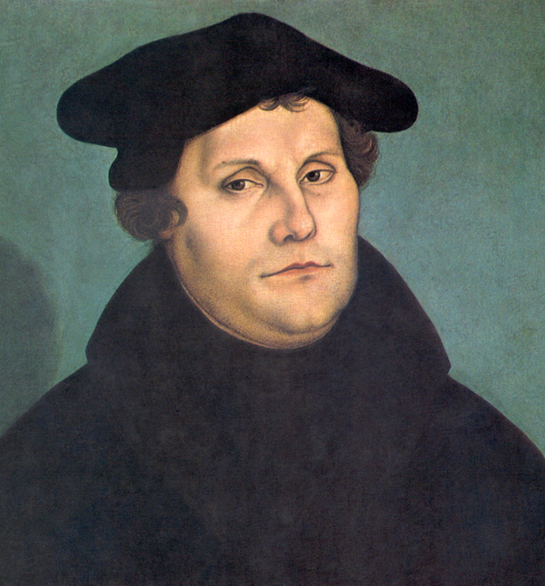
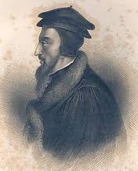
The Protestant Refomation
Martin Luther – 1483-1546
1525 – On the Bondage of the Will
John Calvin – 1509-1564
1536 – 1st edition of Institutes of the Christian Religion – 1st systematic theology

Slide 5
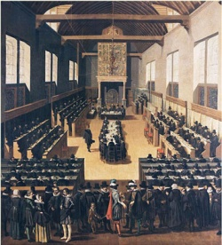
Late 1500’s - Lutherans and Anabaptists move in semi-Pelagian direction
Doctrinal dispute in the Netherlands
Jacobus Arminius – professor at University of Leyden (1603-1609); studied at The Geneva Academy
Taught election based upon foreknowledge, dependent on faith; “prevenient grace”
The Synod of Dort – 1618-19
“Arminians” present “the Remonstrance” with five points of Arminian doctrine
Synod rejects Arminianism as heresy, responds with “the five points of Calvinism” – T.U.L.I.P.
Methodist & Anabaptist Movements – spread Arminianism throughout U.S.

Slide 6
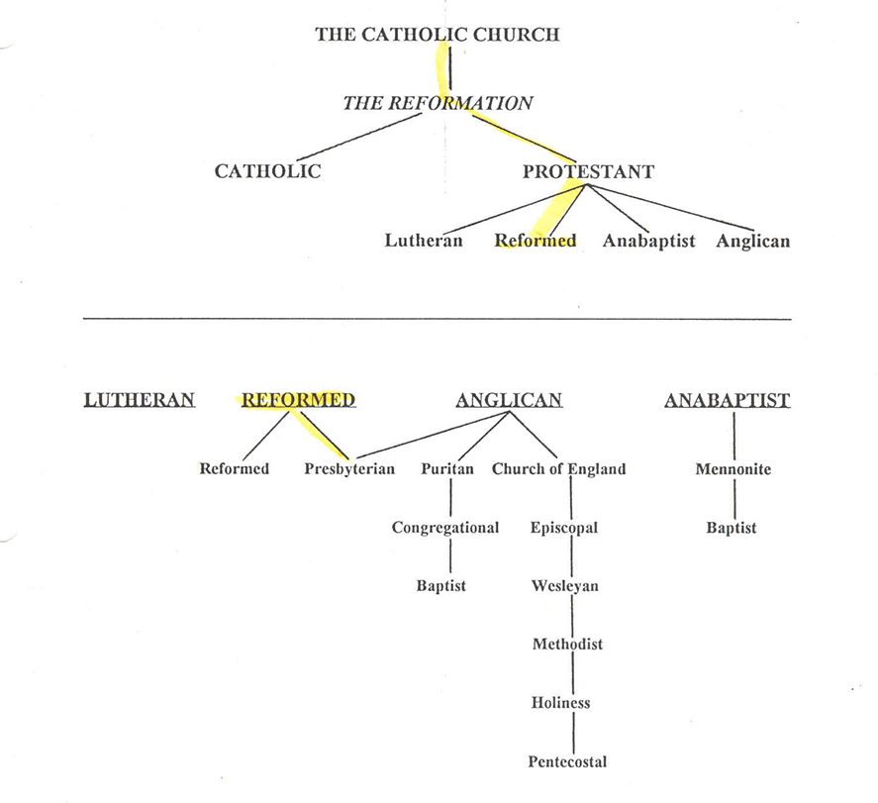

Slide 7
Sovereignty and Salvation
“The illusoriness of free will is as certain a fact, to my mind, as the truth of evolution.” Sam Harris, atheist author
Westminster Confession of Faith (1646), chapter III, paragraph I – “God, from all eternity, did, by the wise and holy counsel of His own will, freely, and unchangeably ordain whatsoever comes to pass…”

Slide 8
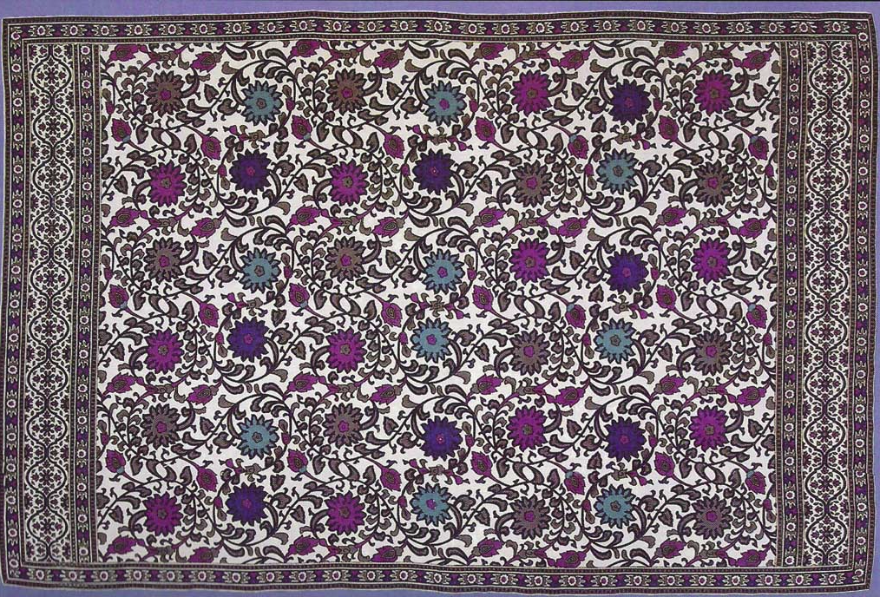
The Tapestry of Grace
“And we know that for those who love God all things work together for good, for those who are called according to His purpose.” Romans 8:28

Slide 9
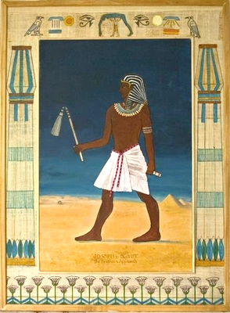
Sovereignty, Secondary Causes, & Sin
God is not the Author of sin, but His plan includes our sins
“And God sent me before you to preserve for you a remnant on earth, and to keep alive for you many survivors. So it was not you who sent me here, but God. He has made me a father to Pharaoh, and lord of all his house and ruler over all the land of Egypt.” Genesis 45:8
As for you, you meant evil against me, but God meant it for good, to bring it about that many people should be kept alive…” Genesis 50:20

Slide 10
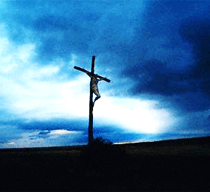
God’s Plan & Purpose
“…this Jesus, delivered up according to the definite plan and foreknowledge of God, you crucified and killed by the hands of lawless men.”
Acts 2:23
“…for truly in this city there were gathered together against Your holy servant Jesus, whom You anointed, both Herod and Pontius Pilate, along with the Gentiles and the peoples of Israel, to do whatever Your hand and Your plan had predestined to take place.” Acts 4:27, 28

Slide 11
T.U.L.I.P.
Total Depravity
Unconditional Election
Limited Atonement
Irresistible Grace
Perseverance of the Saints

Slide 12
Total Depravity What are we capable of contributing to our salvation?
Not Absolute Depravity
Romans 3:10-11 - “…as it is written: ‘None is righteous, no, not one; no one understands, no one seeks for God.”
Romans 8:6,7 – “…the mind that is set on the flesh is hostile to God, for it does not submit to God's law; indeed, it cannot.”
Ephesians 2:1-3 - “And you were dead in the trespasses and sins in which you once walked… and were by nature children of wrath, like the rest of mankind..”

Slide 13
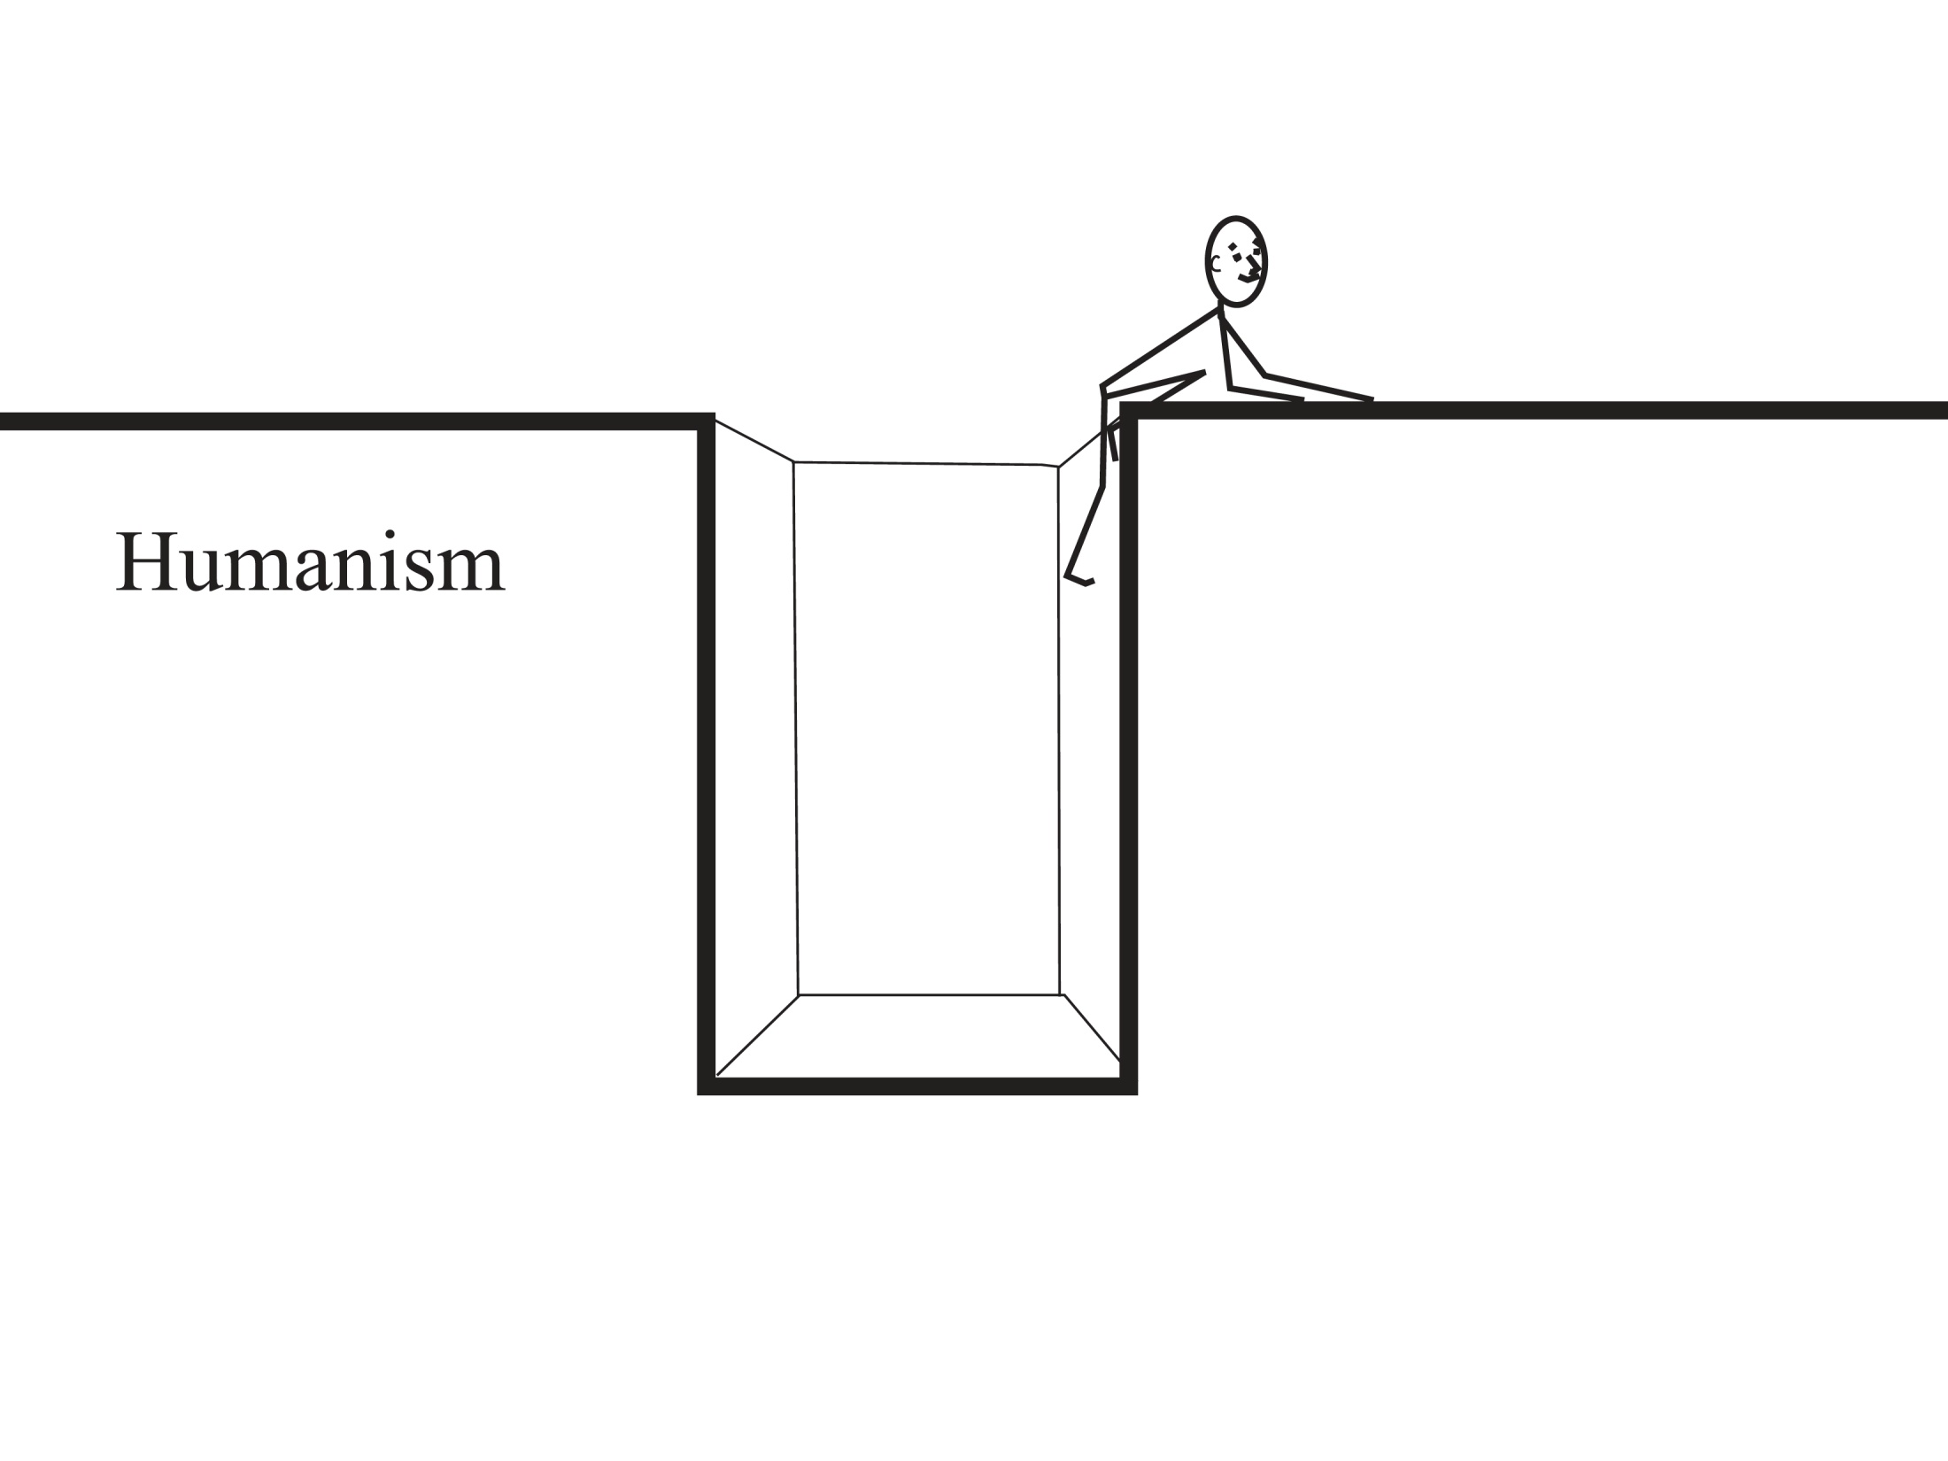

Slide 16
How Free is Our Will?
Ezekiel 11:19-20 - “And I will give them one heart, and a new spirit I will put within them. I will remove the heart of stone from their flesh and give them a heart of flesh, that they may walk in my statutes and keep my rules and obey them.”
John 6:65 - “This is why I told you that no one can come to Me unless it is granted him by the Father.”
Romans 6:17,18 – “But thanks be to God, that you who were once slaves of sin have become obedient from the heart… and, having been set free from sin, have become slaves of righteousness.”

Slide 17
Unconditional Election
Who did the choosing? When? On what basis?
Ephesians 1:3-5, 11 - “…He chose us in Him before the foundation of the world, that we should be holy and blameless before Him. In love He predestined us for adoption as sons through Jesus Christ, according to the purpose of His will …In Him we have obtained an inheritance, having been predestined according to the purpose of Him who works all things according to the counsel of His will…”
Acts 13:48 - “When the Gentiles heard this, they were glad and honored the word of the Lord; and all who were appointed for eternal life believed.”

Slide 18
Is God Unjust?
Romans 9:6,7; 10-16 – “…not all who are descended from Israel belong to Israel, and not all are children of Abraham because they are his offspring, but ‘Through Isaac shall your offspring be named’… And not only so, but also when Rebekah had conceived children by one man, our forefather Isaac, though they were not yet born and had done nothing either good or bad — in order that God's purpose of election might continue, not because of works but because of him who calls— she was told, ‘The older will serve the younger.’ As it is written, ‘Jacob I loved, but Esau I hated.’ What shall we say then? Is there injustice on God's part? By no means! For He says to Moses, ‘I will have mercy on whom I have mercy, and I will have compassion on whom I have compassion.’ So then it depends not on human will or exertion, but on God, who has mercy. ”

Slide 19
Calling
Regeneration
Faith & Repentance
Justification
Adoption
Sanctification
Perseverance
Glorification
The Order of Salvation
“And we know that for those who love God all things work together for good, for those who are called according to His purpose. For those whom He foreknew He also predestined to be conformed to the image of His Son, in order that He might be the firstborn among many brothers. And those whom He predestined He also called, and those whom He called He also justified, and those whom He justified He also glorified..” Romans 8:28-30

