Slide 1
Oakwood Presbyterian Church
2019

Slide 2
Topics
The Authority & Sufficiency of Scripture
Creation, Fall, & Redemption
The Doctrines of Grace (Part I)
The Doctrines of Grace (Part II)
Covenant Theology
The Sacraments (Part I)
The Sacraments (Part II)
The Church

Slide 3
The Authority and Sufficiency of Scripture

Slide 4
Perspectives in History
The Reformation
“Unless I am convinced by the testimony of the Scriptures or by clear reason… I am bound by the Scriptures I have quoted and my conscience is captive to the Word of God. I cannot and will not recant anything....” Martin Luther
Documentary Hypothesis – Julius Wellhausen
The Chicago Statement on Biblical Inerrancy

Slide 5
How Do We Know What is True?
Epistemology – “How do we know what we know?”
How do we know God? Only as He reveals Himself
“Did God actually say…?” Genesis 3:1
“The secret things belong to the Lord our God, but the things that are revealed belong to us and to our children forever, that we may do all the words of this law.” Deut. 29:29

Slide 6
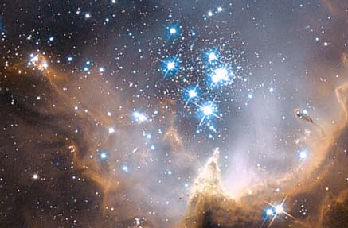
God Reveals Himself in Creation
“For the wrath of God is revealed from heaven against all ungodliness and unrighteousness of men, who by their unrighteousness suppress the truth. For what can be known about God is plain to them, because God has shown it to them. For His invisible attributes, namely, His eternal power and divine nature, have been clearly perceived, ever since the creation of the world, in the things that have been made. So they are without excuse.” Romans 1:18-20

Slide 7
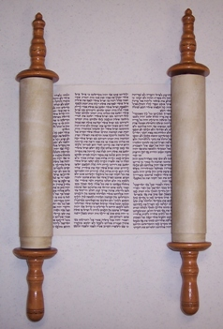
God Speaks – The Bible
“Long ago, at many times and in many ways, God spoke to our fathers by the prophets, but in these last days He has spoken to us by His Son, whom He appointed the heir of all things, through whom also He created the world.” Hebrews 1:1,2
“…from childhood you have been acquainted with the sacred writings, which are able to make you wise for salvation through faith in Christ Jesus. All Scripture is breathed out by God and profitable for teaching, for reproof, for correction, and for training in righteousness, that the man of God may be competent, equipped for every good work.” II Timothy 3:15,16

Slide 8
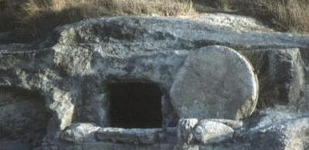
Inspiration
“For we did not follow cleverly devised myths when we made known to you the power and coming of our Lord Jesus Christ, but we were eyewitnesses of His majesty…no prophecy of Scripture comes from someone's own interpretation. For no prophecy was ever produced by the will of man, but men spoke from God as they were carried along by the Holy Spirit.” I Peter 1:16, 20, 21

Slide 9
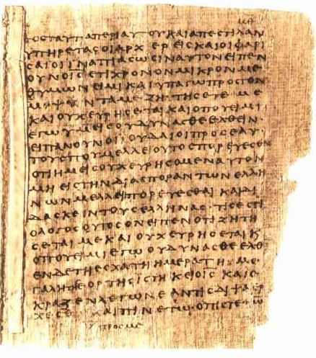
Inspiration & Inerrancy
“…none of these (Scriptural) authors has erred in any respect of writing.” Augustine
“The Old Testament in Hebrew… and the New Testament in Greek… being immediately inspired by God… are therefore authentical; so as, in all controversies of religion, the church is finally to appeal unto them..” Westminster Confession of Faith
“Inerrant” – “…signifies the quality of being free from all falsehood or mistake and so safeguards the truth that Holy Scripture is entirely true and trustworthy in all its assertions.”
The Chicago Statement on Biblical Inerrancy

Slide 10
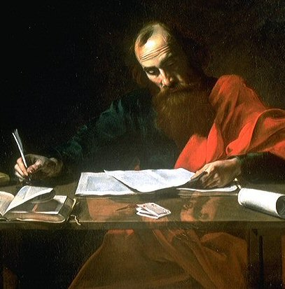
Plenary-Verbal Inspiration
Original “autographs” – perfect in every word and every subject that they address
“Inspiration is that influence of the Holy Spirit which accompanied every thought, feeling, impulse, and action of the sacred writers, as they wrote the Scripture, guiding them in the selection and utterance of truth, so that the very mind of God was expressed with infallible accuracy. The divine influence we call inspiration extended to the verbal expression of every thought, and equally to every part of Scripture, matter and form, thoughts and words, and renders the whole and every part inerrant.” A.A. Hodge

Slide 11
Infallibility
A stronger term than inerrancy – “incapable of deception”
“‘Inerrant’ means there are no errors; ‘infallible’ means there can be no errors.”
John Frame
“We affirm that Scripture, having been given by divine inspiration, is infallible, so that, far from misleading us, it is true and reliable in all the matters it addresses.”
“We deny that it is possible for the Bible to be at the same time infallible and errant in its assertions. Infallibility and inerrancy may be distinguished, but not separated.”
Chicago Statement on Biblical Inerrancy, Article XI

Slide 12
Jesus’ View of Scripture
“For truly, I say to you, until heaven and earth pass away, not an iota, not a dot, will pass from the Law until all is accomplished.” Matthew 5:18
“…Scripture cannot be broken…” John 10:35
Jesus spoke of Old Testament people and events as historical:
Adam & Eve; Abel
Noah
Abraham
Moses – wrote the Penteteuch
Jonah
Isaiah
“Then He said to them, ‘These are my words that I spoke to you while I was still with you, that everything written about Me in the Law of Moses and the Prophets and the Psalms must be fulfilled.’ Then He opened their minds to understand the Scriptures…”
Luke 24:44,45

Slide 13
Prophets’ & Apostles’ View
“Thus says the Lord…” Isaiah 45:14
“…when you received the word of God, which you heard from us, you accepted it not as the word of men but as what it really is, the word of God, which is at work in you believers.” I Thessalonians 2:13
“…just as our beloved brother Paul also wrote to you according to the wisdom given him, as he does in all his letters when he speaks in them of these matters. There are some things in them that are hard to understand, which the ignorant and unstable twist to their own destruction, as they do the other Scriptures.” II Peter 3:15,16
“For the Scripture says, ‘You shall not muzzle an ox when it treads out the grain,’ and, ‘The laborer deserves his wages.’” I Timothy 5:18

Slide 14
The Text of Scripture
There are over 5,300 manuscripts (handwritten copies) of the New Testament – 50 from 100 AD – 300 AD
2nd place – Homer’s Iliad (900 BC) – 653; earliest is from ~400 AD
“The Old Testament in Hebrew… and the New Testament in Greek… being immediately inspired by God, and, by His singular care and providence, kept pure in all ages, are therefore authentical…”
WCF, chapter 1, paragraph 8
“The variant readings in the manuscripts are not of such a nature that they threaten to overthrow our faith. Except for a few instances, we have an unquestioned text; and even then not one principle of faith or command of the Lord is involved.”
Neil Lightfoot

Slide 15
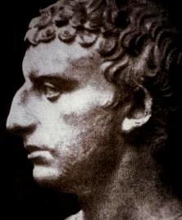
“We have given practical proof of our reverence for our own Scriptures. For, although such long ages have now passed, no one has ventured either to add, or to remove, or to alter a syllable; and it is an instinct with every Jew, from the day of his birth, to regard them as the decrees of God, to abide by them, and, if need be, cheerfully to die for them.”
Josephus, 1st century Jewish historian

Slide 16
“We affirm that inspiration, strictly speaking, applies only to the autographic text of Scripture, which in the providence of God can be ascertained from available manuscripts with great accuracy. We further affirm that copies and translations of Scripture are the Word of God to the extent that they faithfully represent the original.”
“We deny that any essential element of the Christian faith is affected by the absence of the autographs. We further deny that this absence renders the assertion of Biblical inerrancy invalid or irrelevant.”
Chicago Statement on Inerrancy, Article X
“The Christian can take the whole Bible in his hand and say without fear or hesitation that he holds in it the true Word of God, handed down without essential loss from generation to generation throughout the centuries.”
Sir Frederic Kenyon, Biblical scholar, Director and Principal Librarian, British Museum

Slide 17
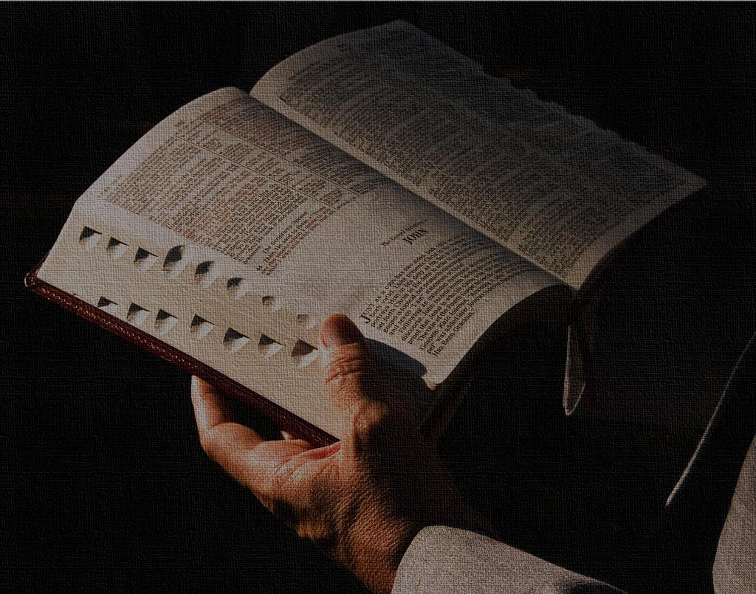
The Sufficiency of Scripture
“You shall not add to the word that I command you, nor take from it, that you may keep the commandments of the Lord your God that I command you.” Deuteronomy 4:2
“The whole counsel of God concerning all things necessary for His own glory, man’s salvation, faith, and life, is either expressly set down in Scripture, or by good and necessary consequence may be deduced from Scripture: unto which nothing at any time is to be added, whether by new revelations of the Spirit, or traditions of men.”
Westminster Confession of Faith, chapter I, para. VI

Slide 18
The Canon of Scripture
“reed” – “rule”, “standard”
Principles of Canonicity:
Apostolicity – written by an Apostle or a close associate of an Apostle
Antiquity – related to Apostolicity; dating to the 1st century
Orthodoxy – teachings consistent with already accepted canon
Universality – used and valued in all places the Church was established
Substantial agreement by 170 AD; Final affirmation by 393 AD
“The Church no more gave us the New Testament canon than Sir Isaac Newton gave us the force of gravity.” J.I. Packer

Slide 19
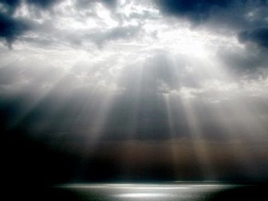
The Word and the Spirit
“Illumination” – the work of the Holy Spirit in the heart and mind of a believer, enabling him / her to hear, understand, accept, and submit to God’s Word
“Now we have received not the spirit of the world, but the Spirit who is from God, that we might understand the things freely given us by God…The natural person does not accept the things of the Spirit of God, for they are folly to him, and he is not able to understand them because they are spiritually discerned.” I Corinthians 2:12-14

Slide 20
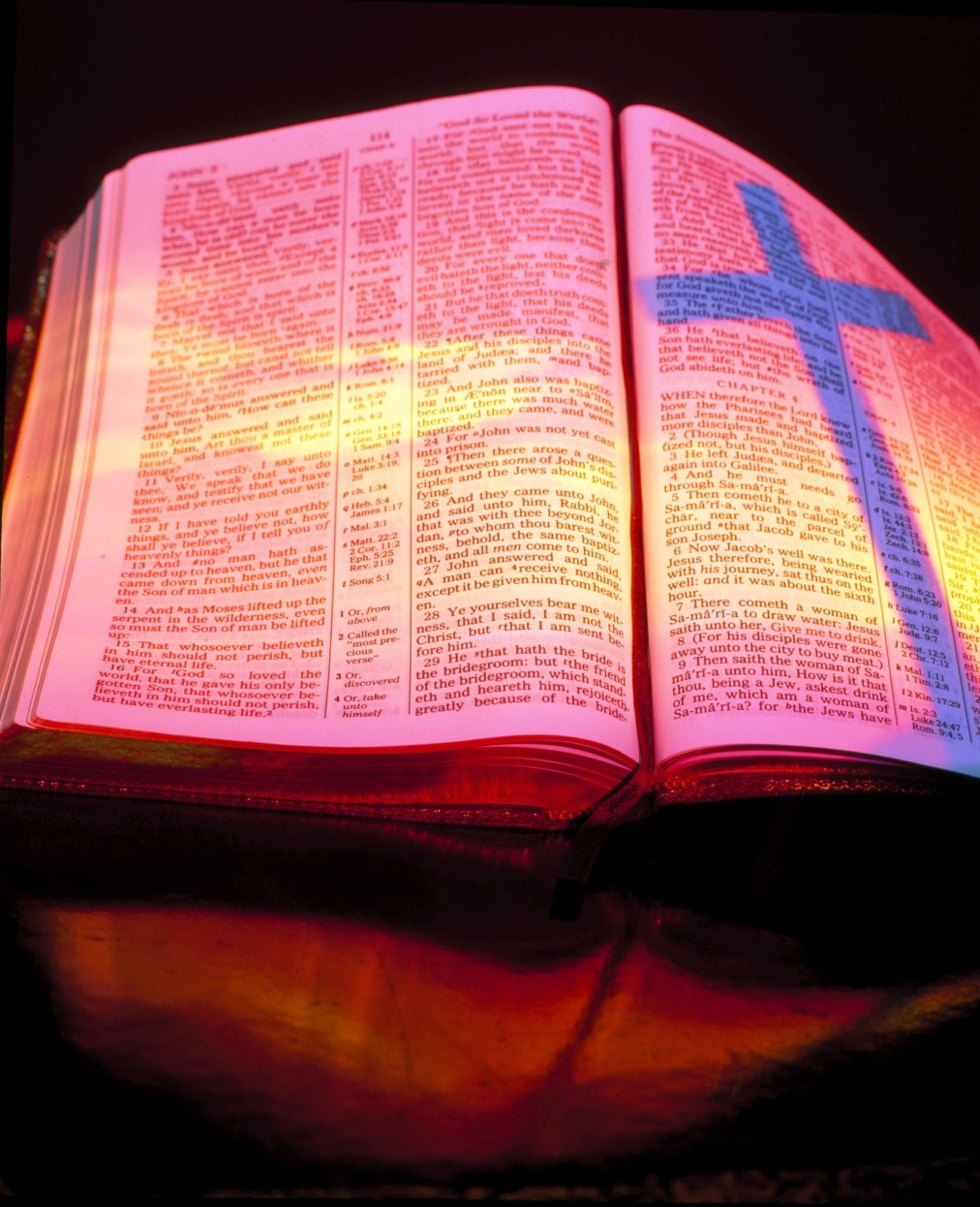
The Subject of Scripture
Jesus: “You search the Scriptures because you think that in them you have eternal life; and it is they that bear witness about Me… if you believed Moses you would believe Me; for he wrote of Me.” John 5:39, 46
“And [Jesus] said to them, ‘O foolish ones, and slow of heart to believe all that the prophets have spoken!... And beginning with Moses and all the Prophets, He interpreted to them in all the Scriptures the things concerning Himself.” Luke 24:25-27
“Here’s what you really can’t get around: If the resurrection happened, then the rest of the fundamental superstructure of Christianity comes together like clockwork – including the authority of the Bible, both New Testament and Old. If it didn’t happen, then never mind any of it…” Greg Gilbert

