Slide 1
The reformation in Scotland

Slide 2
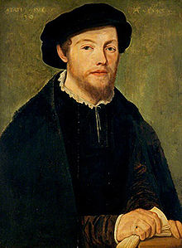
Beginnings of Reform
French-Scottish Alliance
1542 – Mary Stuart (great-granddaughter of King Henry VII) becomes Mary, Queen of Scots at the age of 6 days – heir of English throne after Elizabeth
Raised in France – weds heir of throne in France
Early reformers and martyrs
1543 – Cardinal Beaton reinforces Catholicism
Patrick Hamilton, George Wishart are executed
George Wishart

Slide 3
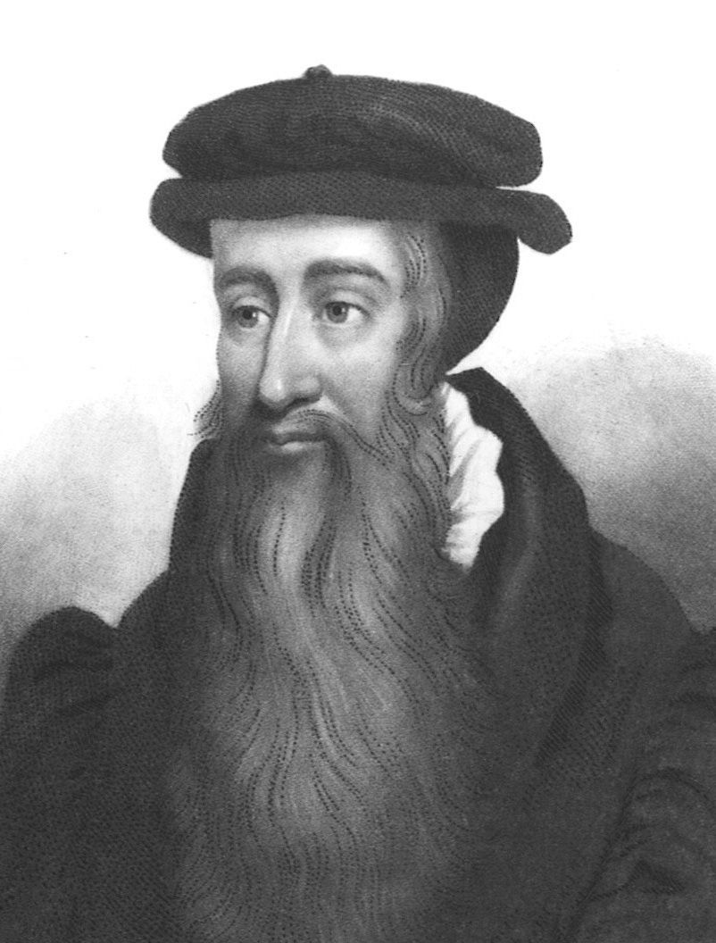
John Knox
Priest; bodyguard for George Wishart
After execution of Wishart, Protestants storm castle at St. Andrews – Knox becomes the pastor
French army sent to re-take St. Andrews – Knox and others taken prisoner – becomes a rower on a galley ship
Freed during reign of Edward VI in England; then flees to Geneva during reign of “Bloody Mary”
Geneva Academy: “The most perfect school of Christ that ever was in the earth since the days of the Apostles”
Writes tract: “The First Blast of the Trumpet Against the Monstrous Regiment of Women”
1559 – Knox returns to Scotland to lead the Reformation

Slide 4
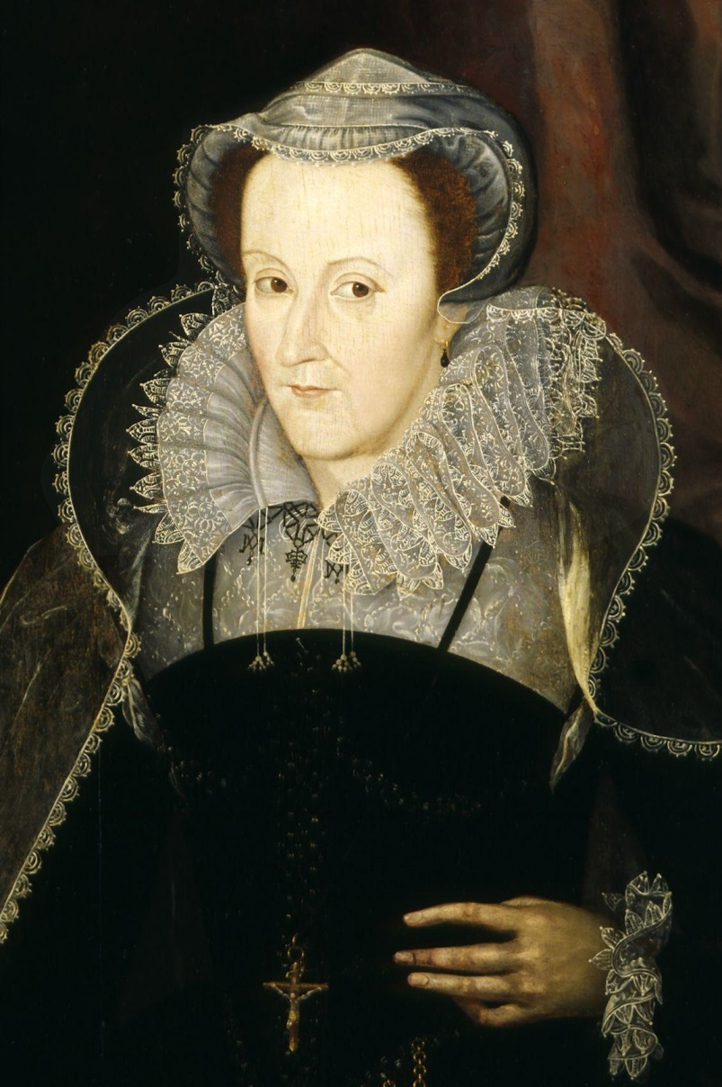
A Swift Reformation
1560 – Queen Elizabeth of England sends troops to oust Mary of Guise, regent for Mary, Queen of Scots
1560 – Scottish Parliament rejects Pope’s authority
Abolishes Catholic teachings & practices
Approves Scottish Confession of Faith, written by John Knox, plus a Book of Order and Book of Discipline
Reformed Church of Scotland established
Queen Mary returns from Scotland, but shortly thereafter flees to England
Accused of plotting against Elizabeth and executed
James VI becomes King of Scotland
Mary, Queen of Scots

Slide 5
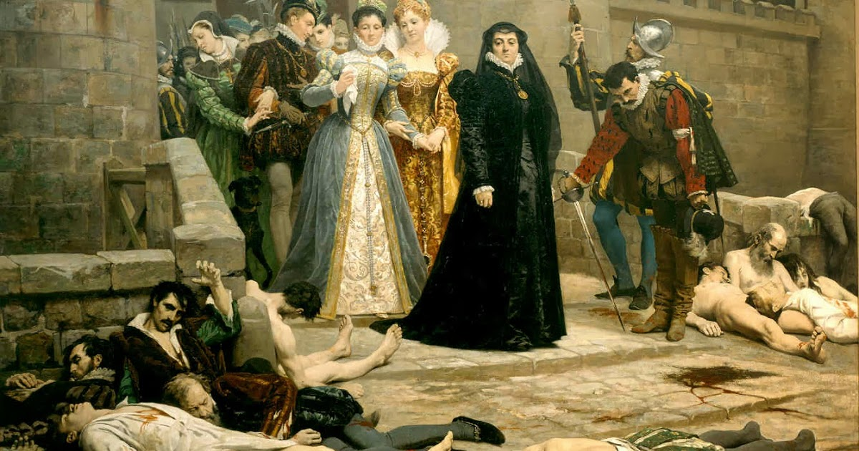
“A powerful France would not have allowed Scotland to be so quickly made Protestant. The outbreak of the French wars of religion destroyed the European power of France and left Mary Queen of Scots helpless upon her uncushioned throne. If the Huguenots failed in France, they indirectly helped to make Calvinism victorious in Scotland.” Owen Chadwick
1572 – John Knox dies; Andrew Melville becomes key leader – wrote about “the divine right of Presbytery” (instead of Kings)
1580 – The National Covenant of Scotland is signed – promise to obey God’s Word

Slide 6
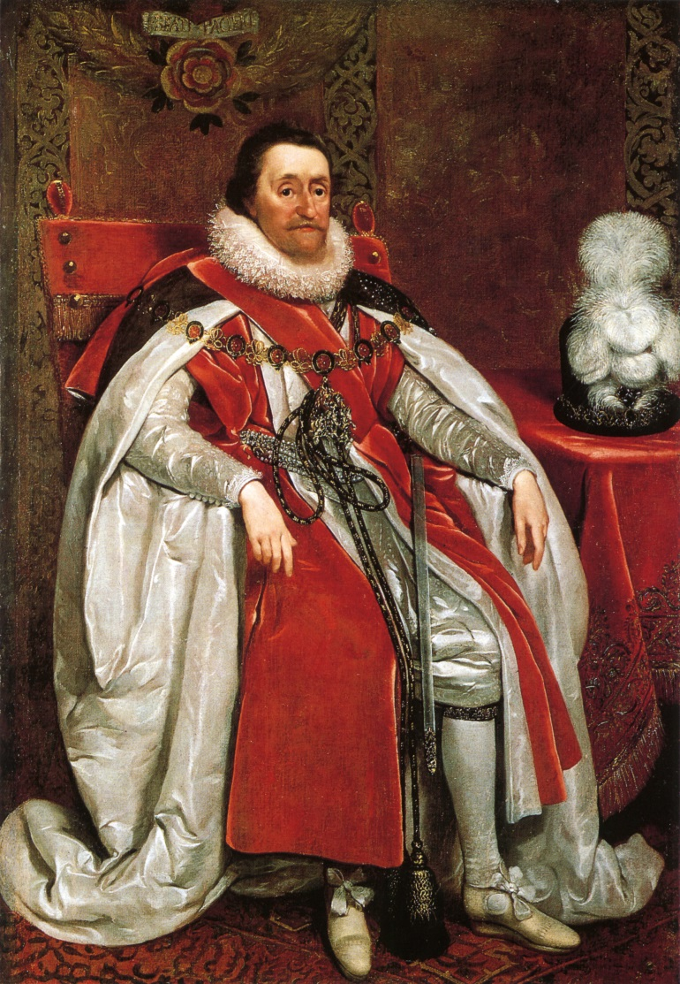
James VI of Scotland – James I of England
1603 – Elizabeth dies – James VI is next in line to the throne; raised Protestant in Scotland
James I opposes the Puritans in England and the Presbyterians in Scotland – seeks to move church back toward Catholicism
Begins forcing Scottish churches to conform to structure and practices of the Church of England
1611 – new translation of the Bible – the KJV
Partly to discourage use of the Geneva Bible

Slide 7
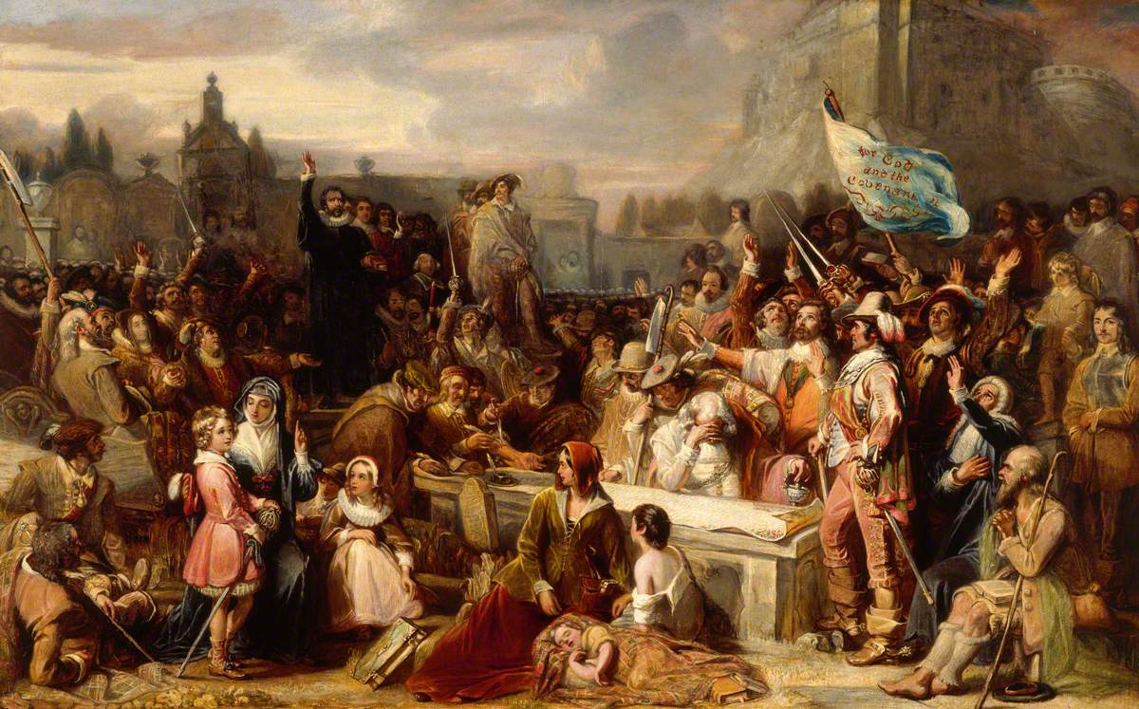
The National Covenant of 1638
1625 – James dies; Charles I becomes king
Charles increases control of church in Scotland under Archbishop Laud, imposing Catholic-style worship
Jenny Geddes – the stool and the riot
1638 – National Covenant – adds grievances against the English throne
Charles calls the English Parliament together for first time in 11 years in order to raise funds for war
Parliament limits King’s powers – civil war breaks out in England

Slide 8
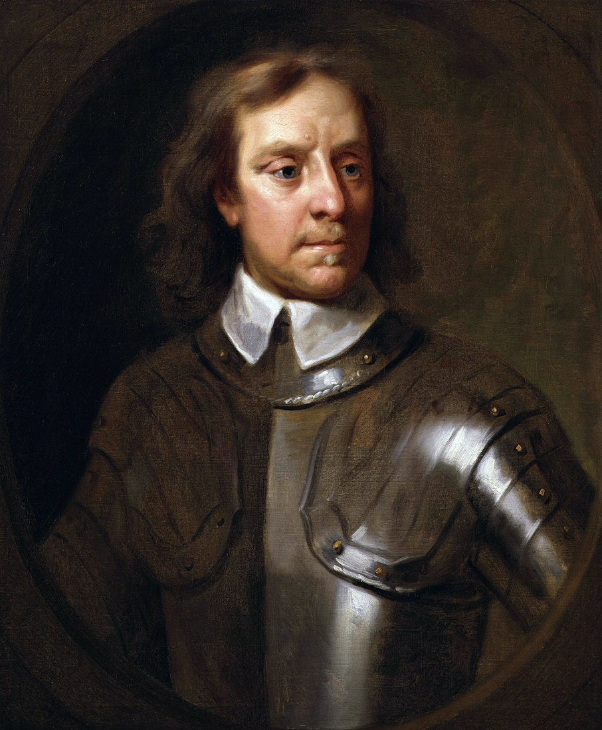
The Civil War in England
1642 – Parliament armies, led by Oliver Cromwell, defeat King’s forces – Charles I is captured and beheaded
Cromwell becomes “Lord Protector” – Puritan Independent
1643 – Solemn League & Covenant – treaty between English Parliament and Scottish Covenanters
Purpose: “to extirpate popery & prelacy”; “to preserve the Church of Scotland and reform the Church of England and of Ireland according to the best Reformed churches”
Oliver Cromwell

Slide 9
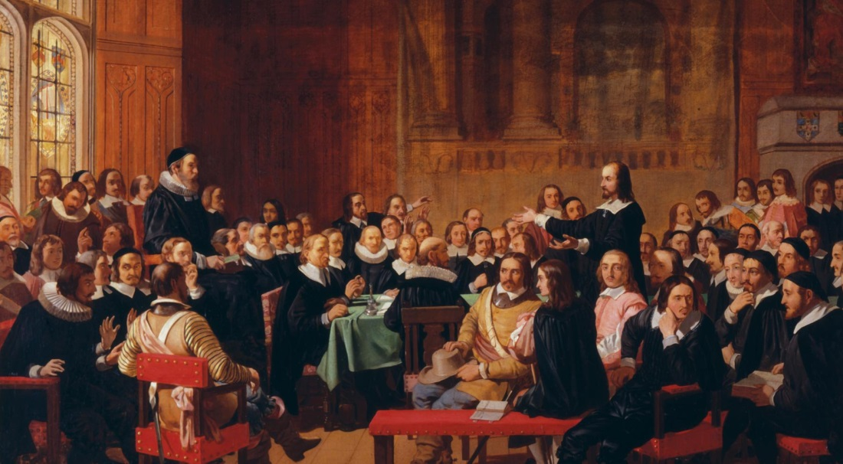
The Westminster Assembly
1643-1649 – over 150 of the leading English and Scottish theologians (Puritan and Presbyterian)
Produces the Confession of Faith, Larger & Shorter Catechisms, Form of Church Government, and Book of Discipline
Immediately accepted by Scottish Parliament but rejected by English Parliament
1650 – Charles II promises Scottish noblemen that he will uphold the Covenants if he is made king
Charles II tries to invade England, but fails – flees to France

Slide 10
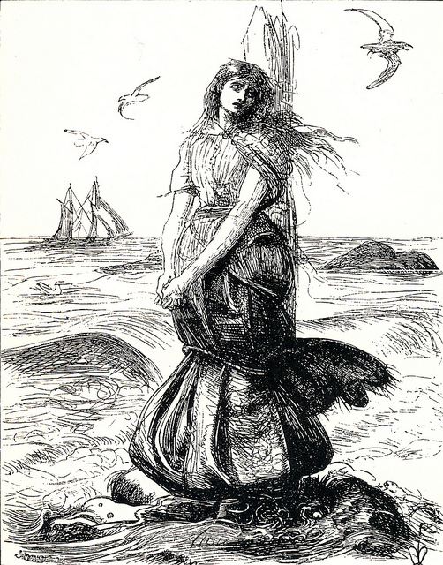
“The Killing Times”
1658 – Cromwell dies; Charles II is invited to take the throne in England
Sees Puritans and Presbyterians as a threat to the throne – imposes doctrine, government, and worship of the Church of England upon Scottish churches
Armed conflict between Covenanters and the English “Dragoons”
1685 – Charles II dies; James II takes the throne and seeks to return the churches of England and Scotland to the Catholic Church
Worst persecution yet – about 1,500 killed
Margaret Wilson

Slide 11
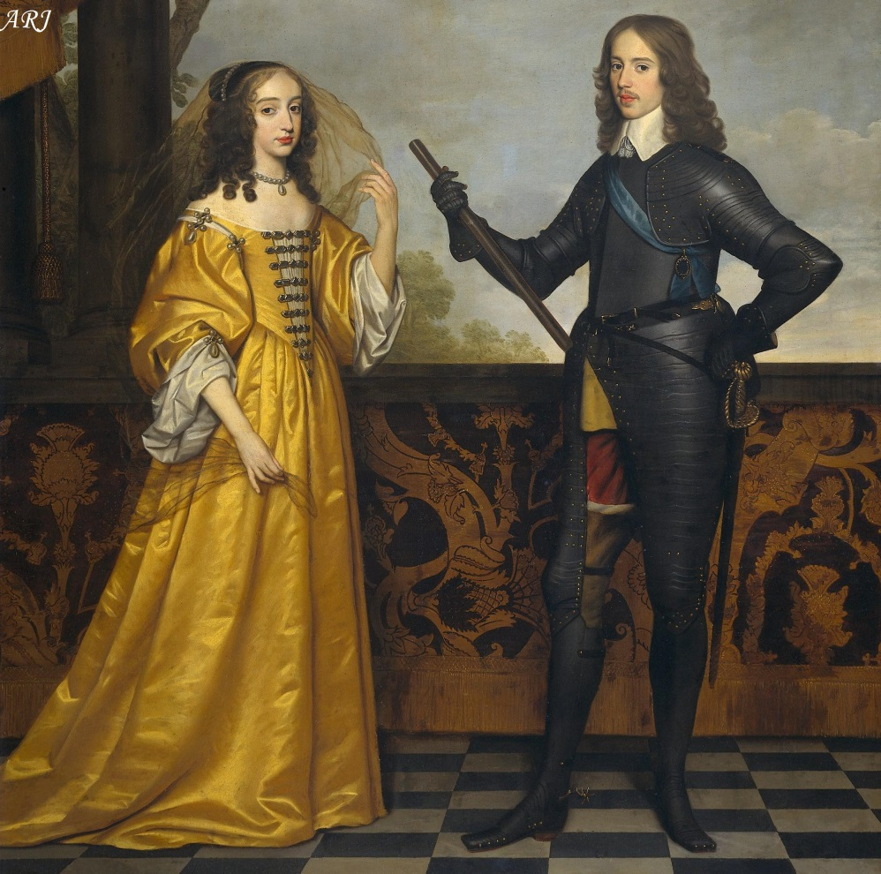
The Glorious Revolution
1688 – English Parliament invites James II’s Protestant daughter, Mary, and her husband, William of Orange (Netherlands) to take the throne
James flees to France, invades Ireland, defeated by William’s armies in “the Battle of the Boyne”
1689 – Revolution Settlement for the Church of Scotland – Presbyterian doctrine, worship, and government restored to the church
First General Assembly - 1690
William and Mary

Slide 12
The Legacy of the Reformation
“Sola Fide”
“Sola Scriptura”
“Solus Christus”
“Sola Gratia”
“Soli Deo Gloria”

