Slide 1
Lesson #4 – The Canon of Scripture

Slide 2
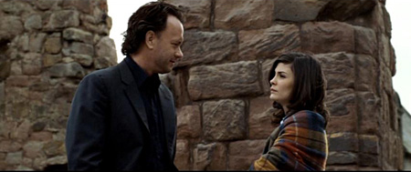
The Modern Myth
“Who chose which gospels to include?” Sophie asked.
“Aha!” Teabing burst with enthusiasm. “The fundamental irony of Christianity!
The Bible, as we know it today, was collated by the pagan Roman emperor Constantine the Great.”
The Da Vinci Code

Slide 3
Canon
Greek word for “reed” – measuring rod, rule, standard, index – list of authoritative books
“canonicity” is based upon authority, not vice versa

Slide 4
The Old Testament Canon
The OT canon was well-established by the time of Jesus and the Apostles
Matthew 21:42 – “ Jesus said to them, ‘Have you never read in the Scriptures: ‘The stone that the builders rejected has become the cornerstone…’”
Luke 24:44 – “…everything written about me in the Law of Moses and the Prophets and the Psalms must be fulfilled.”
Romans 4:3 – “For what does the Scripture say? ‘Abraham believed God, and it was counted to him as righteousness.’”
Origen (200’s), Jerome (300’s), and Masoretic Text all recognize same OT books that we do

Slide 5
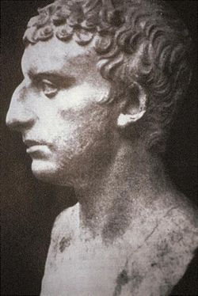
Josephus, 1st Century Jewish Historian
“We have given practical proof of our reverence for our own Scriptures. For, although such long ages have now passed, no one has ventured either to add, or to remove, or to altar a syllable; and it is an instinct with every Jew, from the day of his birth, to regard them as the decrees of God, to abide by them, and, if need be, cheerfully die for them.”
Lists 22 books, combining several of our current day books (e.g., Ruth/Judges, Samuel, Kings, Minor Prophets) – same as our 39 books

Slide 6
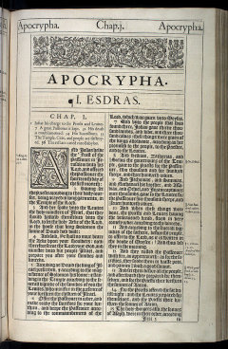
The Apocrypha (OT)
Written between the Testaments – 300 BC – 100 AD; Jewish literature, but not Jewish Scripture
Examples: I & II Maccabees, Tobit, Judith, Susanna, Bel & the Dragon
Some were added to the Septuagint and the Latin Vulgate – but not considered canonical
Rejected by Reformers; accepted by Roman Catholicism & Orthodox Churches (although different books)
Council of Trent (1546 AD) declared the Apocrypha to be canonical
“protocanonical” (original) and “deuterocanonical” (secondary)

Slide 7
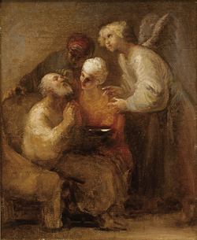
Reasons for Rejection
Jews rejected these books
Jesus and the Apostles rejected these books
Almost every OT book is quoted; no book from the Apocrypha is quoted
They contain historical errors, contradictions (with Scripture and each other), legends
Tobit – miraculous fish innards
e.g., Judith 1:1 – “…Nebuchadnezzar, who ruled over the Assyrians in the great city of Ninevah.”

Slide 8
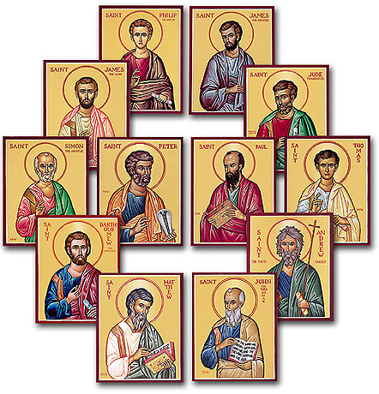
Canon of the New Testament
Authoritative from the beginning:
“But when the Helper comes, whom I will send to you from the Father, the Spirit of truth, who proceeds from the Father, He will bear witness about Me. And you also will bear witness, because you have been with Me from the beginning… I still have many things to say to you, but you cannot bear them now. When the Spirit of truth comes, He will guide you into all the truth, for He will not speak on his own authority, but whatever He hears He will speak, and He will declare to you the things that are to come. He will glorify Me, for He will take what is Mine and declare it to you.”
(John 15:26,27; 16:12-14)

Slide 9
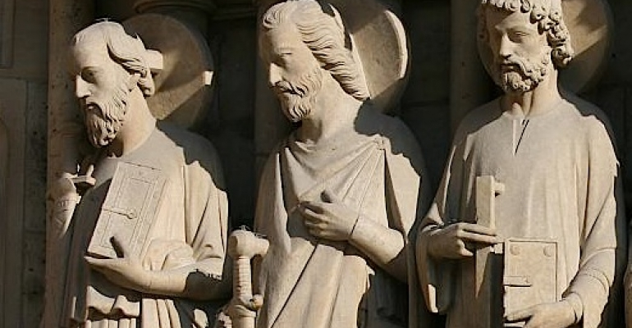
Apostolic Authority
“Peter turned and saw the disciple whom Jesus loved following them… This is the disciple who is bearing witness about these things, and who has written these things, and we know that his testimony is true.” John 21:20,24
“Paul, an apostle – not from men nor through man, but through Jesus Christ and God the Father, who raised Him from the dead…” Galatians 1:1
“ And we also thank God constantly for this, that when you received the word of God, which you heard from us, you accepted it not as the word of men but as what it really is, the word of God, which is at work in you believers.” I Thessalonians 2:13

Slide 10
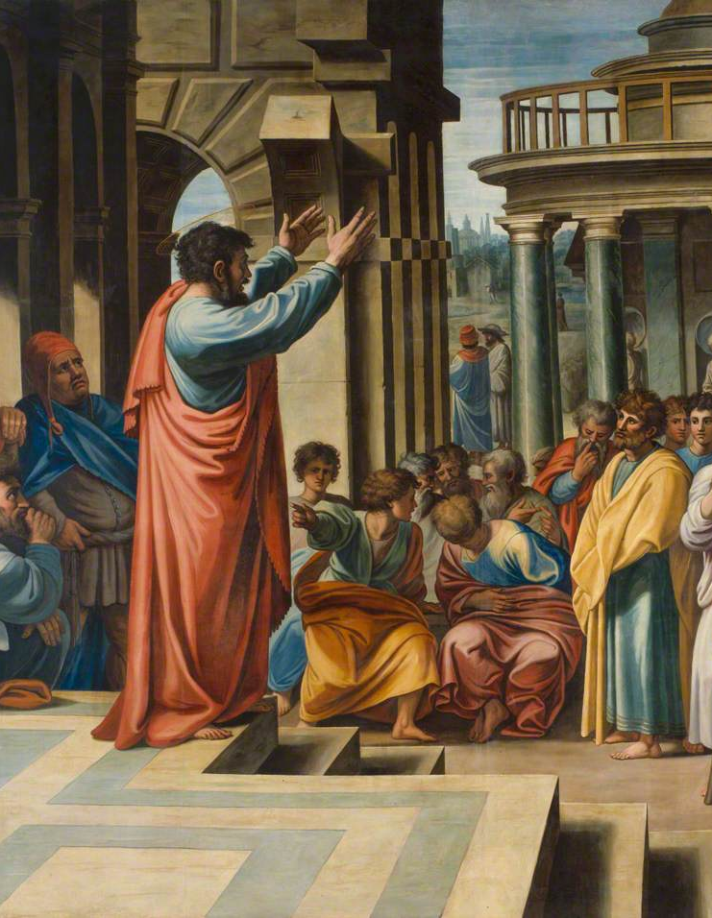
“ If anyone thinks that he is a prophet, or spiritual, he should acknowledge that the things I am writing to you are a command of the Lord.” I Corinthians 14:37
“…just as our beloved brother Paul also wrote to you according to the wisdom given him, as he does in all his letters when he speaks in them of these matters. There are some things in them that are hard to understand, which the ignorant and unstable twist to their own destruction, as they do the other Scriptures.” II Peter 3:15,16

Slide 11
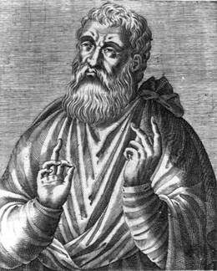
Witness to the Canon – 2nd & 3rd Century
Acts 2:42 – “And they devoted themselves to the apostles' teaching and the fellowship, to the breaking of bread and the prayers.”
A rapidly spreading and persecuted Church
Papias – 110 AD – affirms the four Gospels
Justin Martyr, 150 AD – “…and the memoirs of the apostles or the writings of the prophets are being read as long as it is allowable.”
Justin Martyr

Slide 12
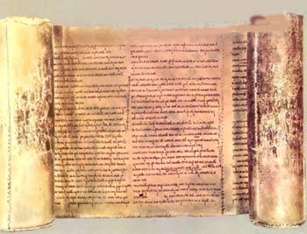
Muratorian Fragment – early, partial list of Apostolic books (late 100’s) – Luke is listed first, but is called the 3rd Gospel; only current books not listed: Hebrews, James, I Peter, II Peter, III John
Irenaus – 180 AD – affirms the four Gospels
Origen – early 200’s AD – originally hesitant regarding Hebrews, James, II Peter, II John, III John; eventually lists the same 27 books we have today

Slide 13
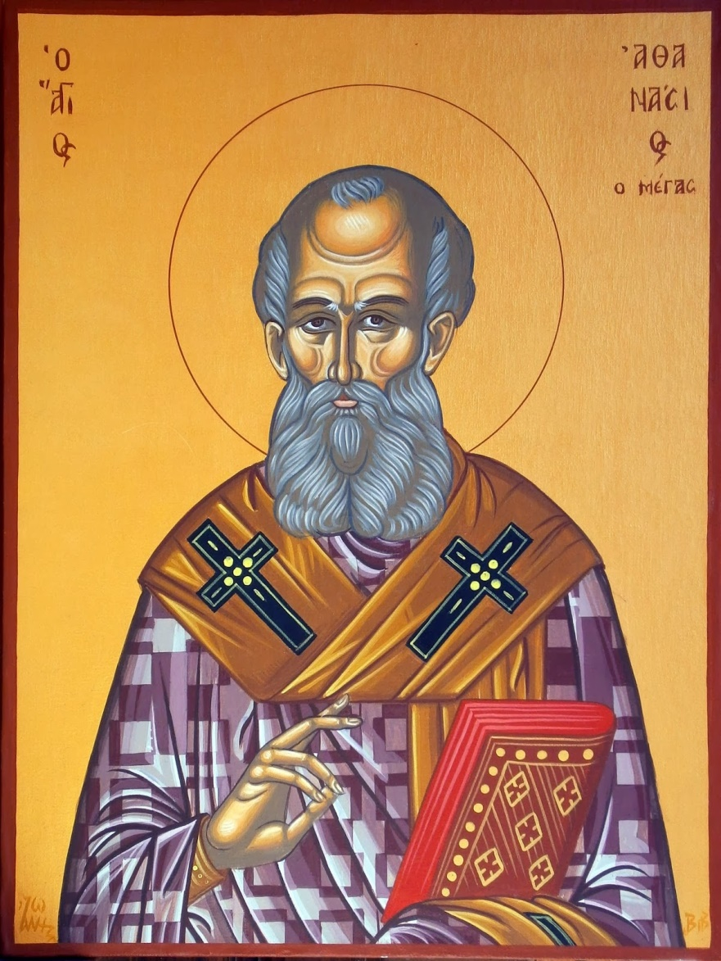
Witness to the Canon – 4th Century
Eusebius –historian – 340 AD
Universally acknowledged: 4 Gospels, Acts, Paul’s epistles, Hebrews, I John, I Peter, Revelation
Disputed: James, Jude, II Peter, II John, III John (not as widely distributed and known; but these were “recognized by the majority”)
Athanasius of Alexandria – 367 AD – same 27 books as today listed as accepted
Rejected books – The Shepherd of Hermas; Epistle of Barnabas; Wisdom of Solomon; I Clement, II Clement
Council of Hippo (393 AD) and Carthage (397 AD) affirm all 27 books
Athanasius

Slide 14
“Over and over again when [the early Christians] wrote about which books were included in the canon and which were not, they used language such as ‘we received’ and ‘these books were handed down.’ Their understanding of their role in the process was not that of a judging, pointing, choosing finger but that of an upturned, open, receiving hand.”
Greg Gilbert, Why Trust the Bible?

Slide 15
Main Criteria for NT Canonicity
Apostolicity – written by an Apostle or a close associate of an Apostle
Antiquity – related to Apostolicity; dating to the 1st century
Orthodoxy – teachings consistent with already accepted canon
Universality – used and valued in all places the Church was established

Slide 16
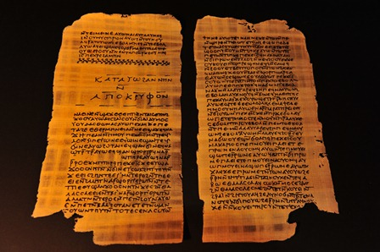
A Rejected Gospel – The Gospel of Thomas
Claims to be apostolic, but fails tests of antiquity, orthodoxy, and universality
Gnostic Gospel, written in late 100’s; considered heretical by early church fathers
“Simon Peter said to them, ‘Let Mary leave us, for women are not worthy of life.’ Jesus said, ‘I myself shall lead her in order to make her male, so that she too may become a living spirit resembling you males. For every woman who will make herself male will enter the Kingdom of Heaven.” The Gospel of Thomas

Slide 17
Westminster Confession of Faith, Chapter 1
1.) Although the light of nature, and the works of creation and providence do so far manifest the goodness, wisdom, and power of God, as to leave men unexcusable; yet are they not sufficient to give that knowledge of God, and of his will, which is necessary unto salvation. Therefore it pleased the Lord, at sundry times, and in divers manners, to reveal himself, and to declare that his will unto his church; and afterwards, for the better preserving and propagating of the truth, and for the more sure establishment and comfort of the church against the corruption of the flesh, and the malice of Satan and of the world, to commit the same wholly unto writing: which maketh the Holy Scripture to be most necessary; those former ways of God's revealing his will unto his people being now ceased.
2.) Under the name of Holy Scripture, or the Word of God written, are now contained all the books of the Old and New Testaments, which are these… All which are given by inspiration of God to be the rule of faith and life.”

Slide 18
3.) The books commonly called Apocrypha, not being of divine inspiration, are no part of the canon of the Scripture, and therefore are of no authority in the church of God, nor to be any otherwise approved, or made use of, than other human writings.
4.) The authority of the Holy Scripture, for which it ought to be believed, and obeyed, dependeth not upon the testimony of any man, or church; but wholly upon God (who is truth itself) the author thereof: and therefore it is to be received, because it is the Word of God.
5.) We may be moved and induced by the testimony of the church to an high and reverent esteem of the Holy Scripture. And the heavenliness of the matter, the efficacy of the doctrine, the majesty of the style, the consent of all the parts, the scope of the whole (which is, to give all glory to God), the full discovery it makes of the only way of man's salvation, the many other incomparable excellencies, and the entire perfection thereof, are arguments whereby it doth abundantly evidence itself to be the Word of God: yet notwithstanding, our full persuasion and assurance of the infallible truth and divine authority thereof, is from the inward work of the Holy Spirit bearing witness by and with the Word in our hearts.

